Slide 1
Aggregates in SQL
SQL Day 3 class

Slide 2
Learning Objectives
By the end of this lesson, you will be able to:
Calculate the average of a numerical value for a group.
Determine the minimum and maximum numerical value for a group.
Count the number of values and unique values for a field.
Aggregate strings into a delimited list.

Slide 3
What is an Aggregate
Aggregates consolidate multiple data points into representative and meaningful statistics.
They aggregate multiple values from a column or table into a consolidated result
Aggregates are useful for summarizing and analyzing data instead of looking at individual records
They provide central tendencies, totals, extremes, and more from a dataset
We can run aggregates on a whole table or on groups within the table
Powerful for summarizing trends, doing analysis, and finding insights

Slide 4
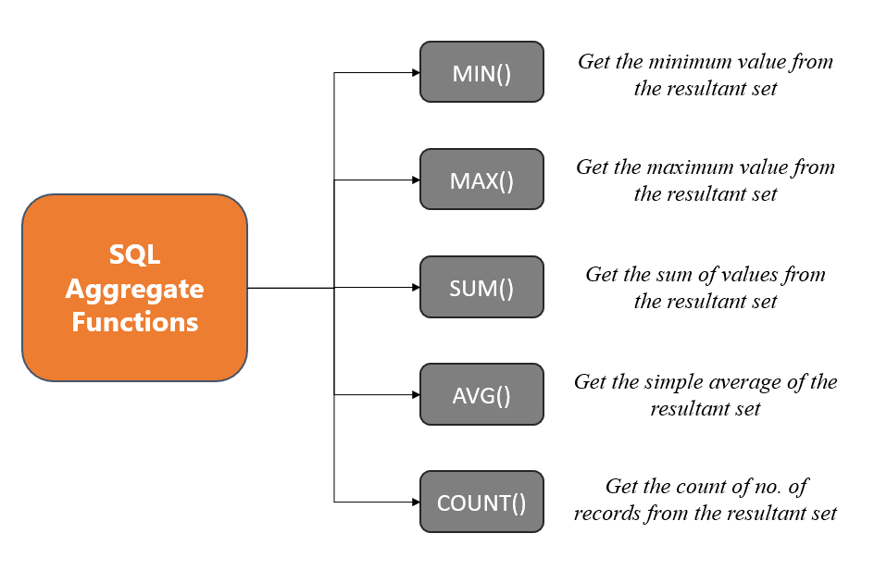
What is an Aggregate
Common Aggregate Functions:

Slide 5
What is an Aggregate
Common Aggregate Functions
SUM()
Totals the values in a column
Useful for running totals, sums of money, sums of quantities
Example: SUM(sales)
totals all sales values
AVG()
Averages the values in a column
Useful as a measure of central tendency
Example: AVG(test_scores)
gets the average test score

Slide 6
What is an Aggregate
Common Aggregate Functions
MIN() and MAX()
Find minimum and maximum values
Useful for finding value ranges and extremes
Example: MIN(expense)
gets lowest expense amount
COUNT()
Counts the number of rows in a column
Useful for counting records, events, and more
Example: COUNT(customers)
counts total customers

Slide 7
Using Aliases with Aggregates
Aliases are useful for renaming columns in aggregate queries
They make column names more readable
Syntax:
AGGREGATE_FUNCTION(column) AS alias_name
Example:
SELECT SUM(TotalDue) AS TotalSales, AVG(LineTotal) AS AverageLineTotal FROM Sales.SalesOrderHeader;

Slide 8
Using Aliases with Aggregates
Benefits:
Results are more understandable
Allows totals/averages to be reused easily
Can reuse aliases for analysis and reporting
Best Practice Tips:
Use descriptive aliases like TotalSales, AveragePrice
Be consistent with alias naming
Avoid spaces and special characters
In summary, use aliases to assign descriptive names to aggregated results! It improves readability and reuse.

Slide 9
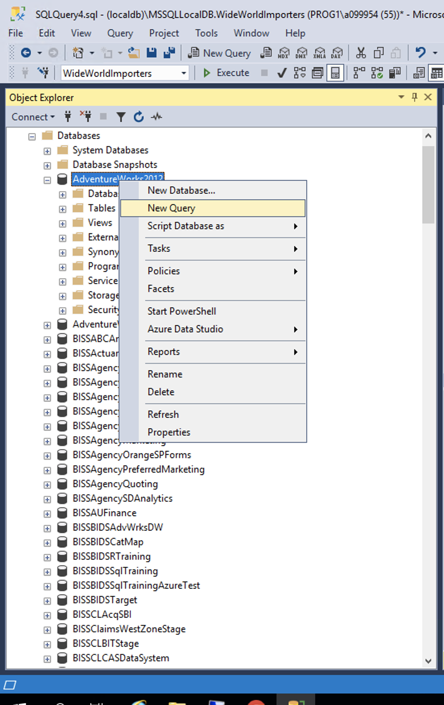
Prep
Using the AdventureWorks Database
Please open up SSMS
Connect to BISS
mss-p1-biss-01
Right click on AdventureWorks2012
Select new query

Slide 10
Using Sum() to Total Values
The SUM() aggregate adds together all numeric values in a column
Useful for:
Getting totals of sales, expenses, balances
Calculating running totals over time
Summarizing numeric data down to a total
Syntax: SUM(column_name)
Examples:
SUM(sales) - Sums all sales
SUM(expenses) - Sums all expenses
SELECT SUM(balance) FROM bank_accounts;

Slide 11
Using Sum() to Total Values
Tips:
Can sum multiples columns simultaneously
Use WITH ROLLUP to subtotal groups
Use filters to sum subsets of data
Limitations:
Only works for numeric data
Ignores non-numeric and NULL values

Slide 12
Using Sum() to Total Values
Examples with AdventureWorks2012 sample database:
Total sales amount for all sales orders in 2012:
SELECT SUM(TotalDue) AS TotalSales FROM Sales.SalesOrderHeader WHERE OrderDate BETWEEN ‘2005-01-01' AND ‘2007-12-31';
Sum of line totals for all details for Sales Order #43659:
SELECT SUM(LineTotal) AS TotalLineAmount FROM Sales.SalesOrderDetail WHERE SalesOrderID = 43659;

Slide 13
Using AVG() to Get Averages
The AVG() aggregate calculates the average value in a column
Useful for finding:
Central tendencies of data
Mean values of measurements
Average metrics over time
Syntax: AVG(column_name)
Examples:
AVG(test_scores)
AVG(expense BY month)
SELECT AVG(salary) FROM employees;

Slide 14
Using AVG() to Get Averages
Tips:
Can average multiple columns at once
Handles numeric columns only
Ignores NULL values
Limitations:
Sensitive to outliers
Doesn't show distribution

Slide 15
Using AVG() to Get Averages
Examples with AdventureWorks2012 sample database:
Find the average list price of products:
SELECT AVG(ListPrice) AS AverageListPrice FROM Production.Product;
Get the average line total across all sales order details:
SELECT AVG(LineTotal) AS AverageLineTotal FROM Sales.SalesOrderDetail;
Calculate the average rate from the employee pay history table:
SELECT AVG(Rate) AS AveragePayRate FROM HumanResources.EmployeePayHistory;

Slide 16
Using MIN(), MAX()
MIN() and MAX()
Find minimum and maximum values in a column
Useful for finding extremes and value ranges
Example:
SELECT MIN(ListPrice) AS MinPrice, MAX(ListPrice) AS MaxPrice FROM Production.Product;

Slide 17
Using MIN(), MAX()
Tips:
Can filter by conditions first
Combine with GROUP BY to count groups
Handle any data type
Limitations:
MIN()/MAX() work on numeric/date data

Slide 18
Using MIN(), MAX(), and Count()
Examples with AdventureWorks2012 sample database:
Finding the lowest and highest list prices for products:
SELECT MIN(ListPrice) AS MinListPrice, MAX(ListPrice) AS MaxListPrice FROM Production.Product;
Determining the earliest and latest hire dates for employees:
SELECT MIN(HireDate) AS EarliestHire, MAX(HireDate) AS LatestHire FROM HumanResources.Employee;

Slide 19
Using Count and COUNT(DISTINCT)
Understanding COUNT()
COUNT()
Counts total number of rows
Includes null and duplicate rows
COUNT(column)
Counts rows with non-null values in column
Leaves out rows where column is null
COUNT(DISTINCT column)
Counts total unique/distinct values
Eliminates duplicates to count only distinct

Slide 20
Using Count and COUNT(DISTINCT)
Examples:
SELECT COUNT(*) FROM table;
All rows
SELECT COUNT(column1) FROM table;
Only non-null column1 rows
SELECT COUNT(DISTINCT column2) FROM table;
Unique values in column2
Use Cases:
Row counts in table or group
Count of non-null column values
Tally distinct values

Slide 21
Using Count and COUNT(DISTINCT)
Examples with AdventureWorks2012 sample database:
Count total rows in Product table:
SELECT COUNT(*) FROM Production.Product;
Count products that have a color specified:
SELECT COUNT(Color) FROM Production.Product;
Count distinct product colors:
SELECT COUNT(DISTINCT Color) FROM Production.Product;
Count distinct customer territories:
SELECT COUNT(DISTINCT TerritoryID) FROM Sales.Customer;

Slide 22
Using the Group By Clause
GROUP BY groups rows with matching values
It is used with aggregate functions to group calculations
Basic syntax:
SELECT columns, aggregates FROM table GROUP BY grouping_column;
Examples:
GROUP BY CustomerID, OrderYear
GROUP BY Region, COUNTRY(Location)

Slide 23
Using the Group By Clause
Key Tips:
Group numeric and date columns easily
Use aliases to rename groups
Single or multiple grouping columns
Filter groups with HAVING clause
Combine with ORDER BY to sort groups
Limitations:
GROUP BY requires you to either group by or aggregate any non-grouping columns in the select statement. Getting this right can be tricky.
Grouping and aggregating large datasets can be resource intensive and slow if not optimized properly with indexes and selective criteria.

Slide 24
Using the Group By Clause
Examples with AdventureWorks2012 sample database:
Total sales by year:
SELECT YEAR(OrderDate) AS OrderYear, SUM(TotalDue) AS TotalSales FROM Sales.SalesOrderHeader GROUP BY YEAR(OrderDate);
Average weight by product size:
SELECT Size, AVG(Weight) AS AverageWeight FROM Production.Product WHERE Weight IS NOT NULL GROUP BY Size;
Minimum list price by style:
SELECT Style, MIN(ListPrice) AS MinimumListPrice FROM Production.Product WHERE Style IS NOT NULL GROUP BY Style;

Slide 25
Using the HAVING Clause
The HAVING clause filters query results based on aggregate conditions after the GROUP BY.
Key Differences from WHERE:
WHERE filters rows before aggregation
HAVING filters groups after aggregation
HAVING works on aggregated results
Basic SQL Syntax:
SELECT group_columns, aggregates
FROM table GROUP BY grouping_columns
HAVING conditional_check;

Slide 26
Using the HAVING Clause
Example Using HAVING:
SELECT year, SUM(sales) AS total_sales FROM data GROUP BY year HAVING SUM(sales) > 1000000;
Use Cases:
Filter to significant groups
Check for aggregate thresholds
Focus analysis on subset of data

Slide 27
Using the HAVING Clause
Examples with AdventureWorks2012 sample database:
Get product categories with more than 20 products:
SELECT ProductSubcategoryID, COUNT(ProductID) AS ProductCount FROM Production.Product GROUP BY ProductSubcategoryID HAVING COUNT(ProductID) > 20;
Show product colors with an average standard cost over $100:
SELECT Color, AVG(StandardCost) AS AverageCost FROM Production.Product WHERE Color IS NOT NULL GROUP BY Color HAVING AVG(StandardCost) > 100;
List product sizes with at least 5000 total quantity in stock:
SELECT Size, SUM(SafetyStockLevel) AS TotalQuantity FROM Production.Product WHERE Size IS NOT NULL GROUP BY Size HAVING SUM(SafetyStockLevel) > 5000;

Slide 28
Exercise
Introduction: AdventureWorks Sample Database
Includes data for fictitious bike manufacturer
Widely used to demonstrate SQL Server examples
We will query and analyze data Using the Production.Product table
Instructions: Follow the steps outlined in each section.

Slide 29
Exercise
Section 1: Aggregates
Write a query to get the total stock value across all products by multiplying the standard cost and quantity for each product and summing those values.
Write a query to find the average weight of products
Write a query to output the minimum and maximum list price of products
Write a query to count the number of unique product colors

Slide 30
Exercise
Section 1: Aggregates
Write a query to get the total stock value across all products by multiplying the standard cost and quantity for each product and summing those values.
SELECT SUM(SafetyStockLevel * StandardCost) AS TotalStockValue FROM Production.Product;
2. Write a query to find the average weight of products
SELECT AVG(Weight) AS AverageWeight FROM Production.Product WHERE Weight IS NOT NULL;

Slide 31
Exercise
Section 1: Aggregates
Write a query to output the minimum and maximum list price of products
SELECT MIN(ListPrice) AS MinPrice, MAX(ListPrice) AS MaxPrice FROM Production.Product;
Write a query to count the number of unique product colors
SELECT COUNT(DISTINCT Color) AS NumColors FROM Production.Product WHERE Color IS NOT NULL;

Slide 32
Exercise
Section 2: Group By & Having
Write a query to group products by product class and return the count of products in each class group.
Write a query to group products by size, get the count of products per size, filter to only sizes that have over 20 products, and sort the groups by descending count.
Write a query to group products by color, calculate the average standard cost per color group, and then use HAVING to only return groups with an average cost greater than $100 per color.

Slide 33
Exercise
Section 2: Group By & Having
Write a query to group products by product class and return the count of products in each class group.
SELECT Class, COUNT(ProductID) FROM Production.Product GROUP BY Class;
Write a query to group products by size, get the count of products per size, filter to only sizes that have over 20 products, and sort the groups by descending count.
SELECT Size, COUNT(ProductID) FROM Production.Product WHERE Size IS NOT NULL
GROUP BY Size HAVING COUNT(ProductID) > 20
ORDER BY COUNT(ProductID) DESC;

Slide 34
Exercise
Section 2: Group By & Having
Write a query to group products by color, calculate the average standard cost per color group, and then use HAVING to only return groups with an average cost greater than $100 per color.
SELECT Color, AVG(StandardCost)
FROM Production.Product WHERE Color IS NOT NULL
GROUP BY Color HAVING AVG(StandardCost) > 100;

